Slide 1

2020管培生周报
虚拟项目第1周
汇报人：温东胜
导师：
类别：
组别：

Slide 2
内容（行动，做了什么）： 1.Configures environment variables of various development software on Windows,sush as python,pyzmq,git,gcc,g++,ect. 2.Install the development tools such as SourceTree,Sublime,VS2015,Qt Creator,PyCharm community,Beyond Compare on Windows platform. 3.Practice and learn the use of DMM,scope and signal generator. 4.Registered gitlab email account , created a warehouse , and used SourceTree tool to manage code. 5.Completed a task of C++ test paper and ZMQ task based on python language. | 结果（采取行动之后取得了哪些结果）： The development software on the computer has been able to use normally,successfully learned to use SourceTree to Push an Pull code , successfully learned to use DMM, scope an signal generator, more familiar with the use of C++ language pointer,and successfully learned to use Python language to realize ZMQ communication protocol.

Slide 3
得失（总结收获与经验心得）： Before entering the company, I was full of unknown about my future. I didn't know which aspect I should choose to develop and which direction I should sduty in depth.However,after this week's training and study in the Intelligent. I gradually found my own advantages,made clear what I was good at, and which direction I would go in future. At the same time, in the week of training , I have mastered the use of the tool of SourceTree and understood the importance of team communication and cooperative development projects. In the future ,I will work hader to realize my maximum value for the Intelligence.
建议想法（对工作、培训等的建议意见）： Hope to increase the study time and practice.

Slide 4
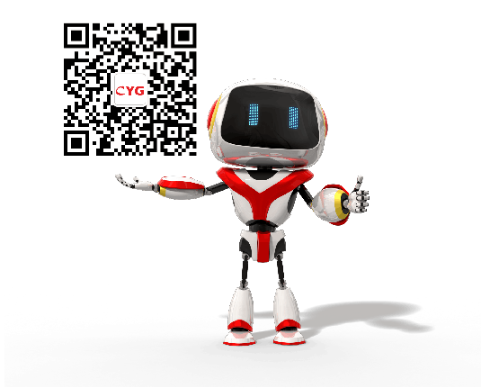
Thanks for the opportunity！
长园运泰利自动化设备有限公司
Tel：0756-6318588-8577
Email：marketing@cygia.com
www.cygia.com

